Slide 1
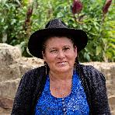
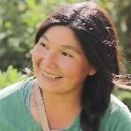
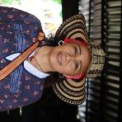
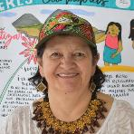
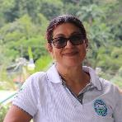
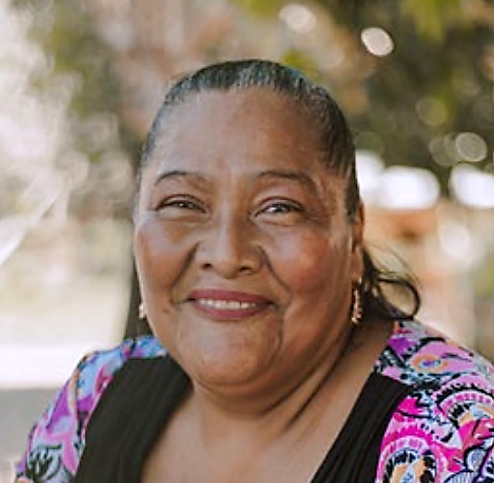
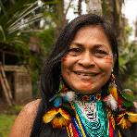
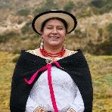
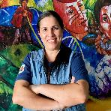
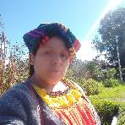
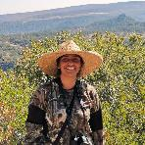
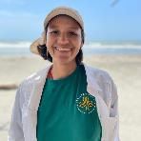
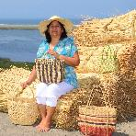
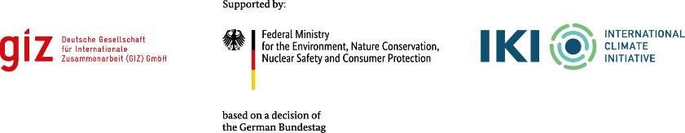
Biodiversity Loss and Climate Change are also Gender Issues
Stories of 13 Women Fighting the Effects of Climate Change and Biodiversity Loss in Latin America

Slide 2
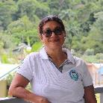
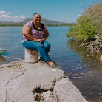
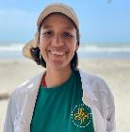
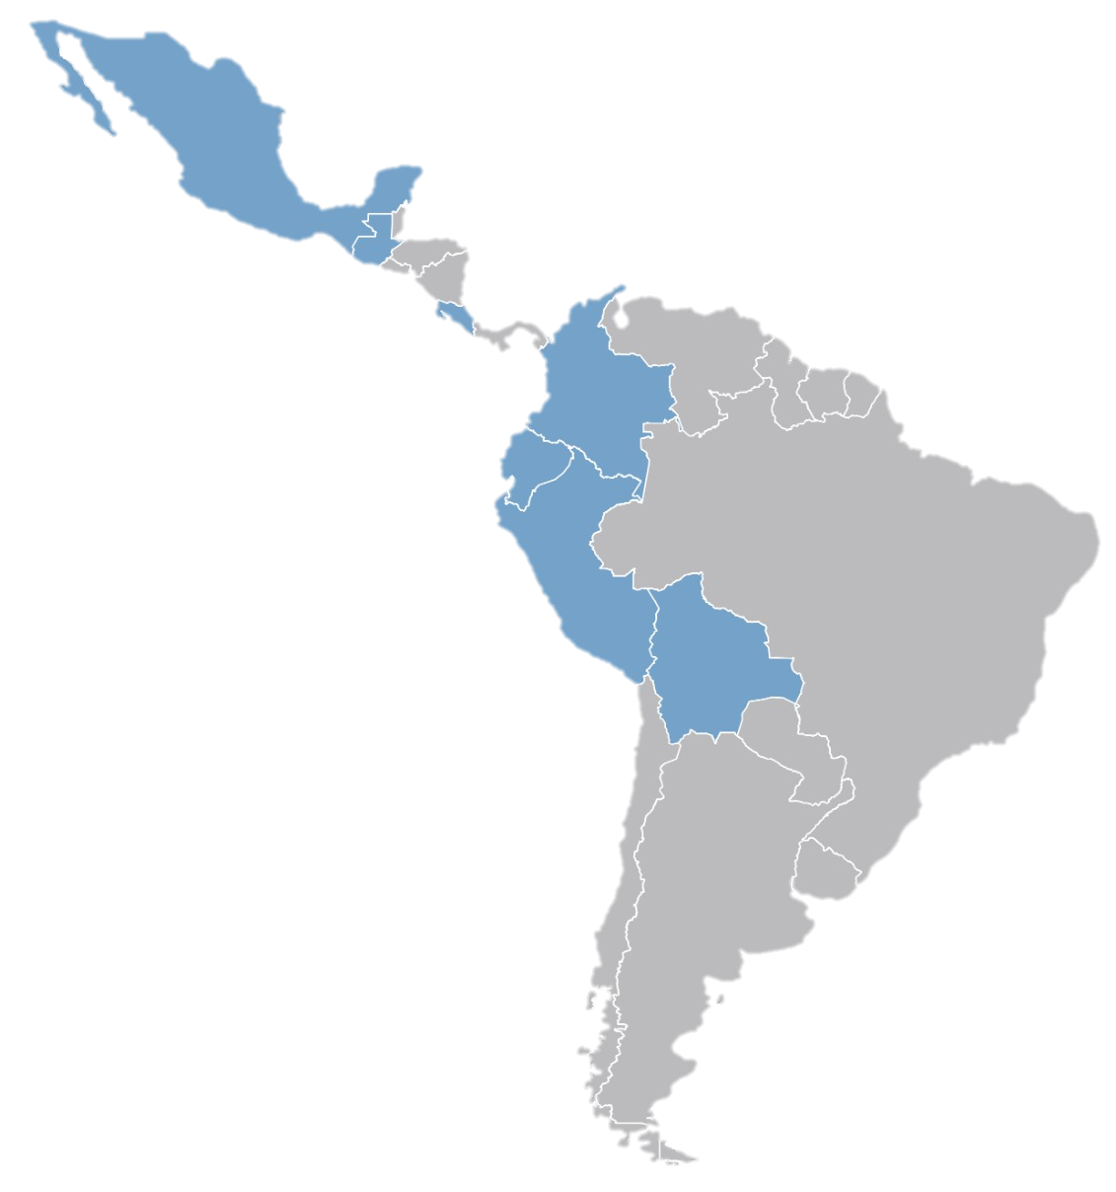
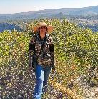
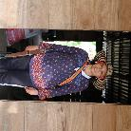

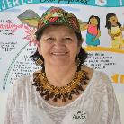
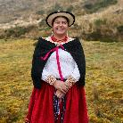

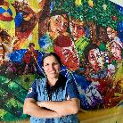
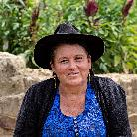
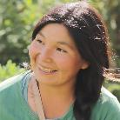
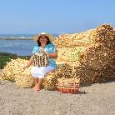
13 WOMEN FROM LATIN AMERICA
Mexico
“Cuando las mujeres nos decidimos, podemos desenvolvernos en cualquier cargo, pero es necesario tener decisión, las mujeres no podemos quedarnos atrás.”
Roxelia Vargas
Water Protector
Silvia Campos Heroine of the Sea
Perseida Tenorio Toledo
Restoring our Rivers
Guatemala
Ana Paola Rangel
Water Harvesting
Costa Rica
Delma Lucía Díaz Martínez Seeding Change
Ma. Cristina Par Tuluxan
Rescuing Biodiversiy
Ecuador
Colombia
Peru
Bolivia
Nelly Antonia Velandia
From the Field for Policy Making
Ma. Florencia Pichisaca Pichazaca
For Equality and Conservation
Tarcila Ankuash Shacay
Shuar Women Preserving their Culture and Forest
Ligia Sánchez Zambrano
Financial Inclusion
Ana Rodas
Preparing for Resilience
Trinidad Franco
Friendly Crops
Prudencia Yolanda Osorio Yunca Craft that Shapes a Sustainable Future

Slide 3


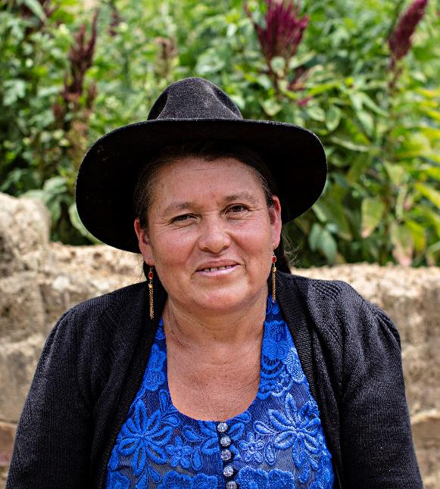
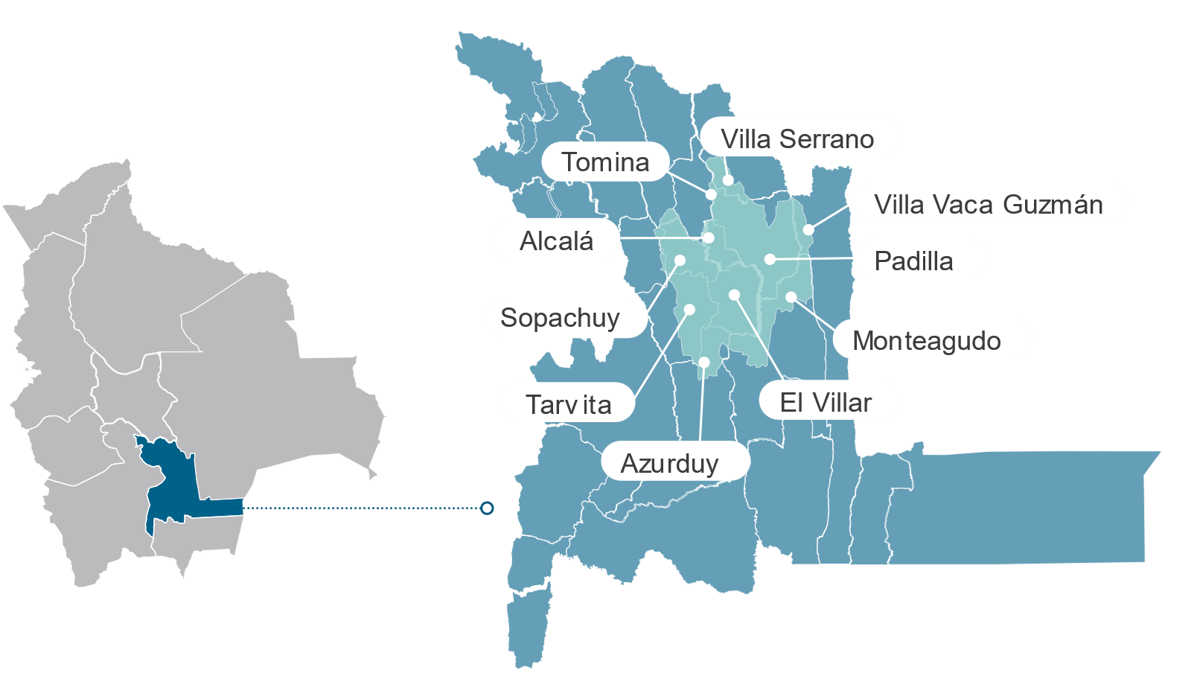
PREPARING FOR RESILIENCE
Ana Rodas: her Journey towards Sustainability
BOLIVIA
In light blue, the Río Azero watershed,
Chuquisaca Department, Bolivia
Ana grew up in the valleys of southern Bolivia, where she has been involved in agriculture and beekeeping since she was a young child. Since the age of 14, Ana has actively participated in her father's labor union, establishing herself as a leader in her community throughout her life.
Since 2020, she has been president of the Río Azero Watershed Community Council. She lives in the municipality of El Villar, in the Azero watershed, in Chuquisaca, where, in addition to her work in the union and in agricultural production, she is a mother.

Slide 4
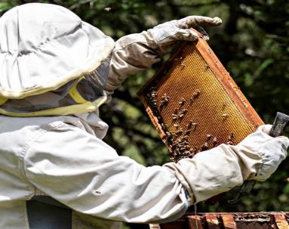
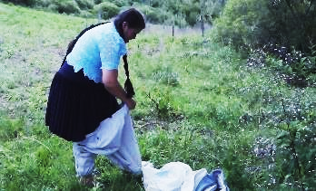
Motivation
Context
Ana comes from a long line of smallholder farmers and promotes beekeeping in her community. Listening to her community and understanding their needs inspired her to access training and participate in decision-making bodies, especially in natural resources management.
“The primary concern for our sisters and brothers in agriculture is to improve production; without water, there is no produce. This is why we are looking to improve water usage, drip- and sprinkler irrigation, as well as water harvesting to ensure high productivity and improve our family’s income. As a leader, I am responsible for helping my community implement the Río Azero Watershed Management Plan and support access to water resources."
In the Río Azero watershed, the effects of climate change have become visible with prolonged droughts or floods that seriously affect agriculture and beekeeping, impacting these economic activities and people's livelihoods.
The rainy season brings large amounts of water that affect the crops, but it also allows the creation of reservoirs that help combat drought in the summer. Our communities are working for the protection and restoration of wetlands, forests, and native plants.
It is crucial to strengthen water management in the watershed through local community participation.
Ana during her beekeeping
activities in the basin

Slide 5
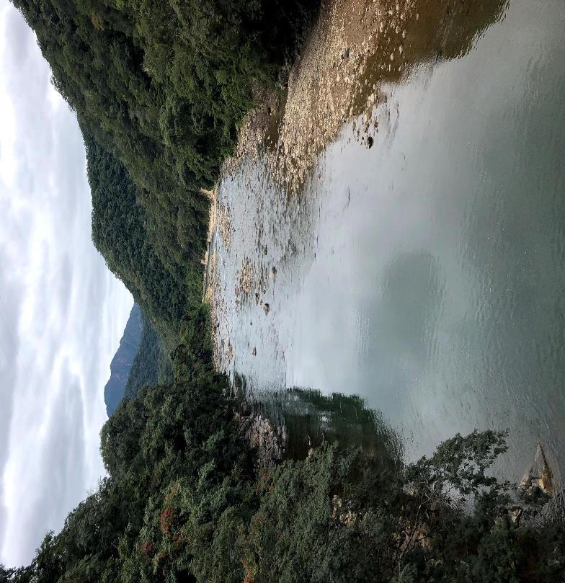
Actions
Watershed protection activities are planned in a participatory manner on the Azero watershed multi-stakeholder platform.
The Community Council is part of the multi-stakeholder platform. Through active participation, Ana promotes projects to improve water security.
The main goal is to secure water quantity and quality for the entire watershed.
Together with local and national stakeholders, Ana worked on the preparation and approval of the Azero watershed plan, which identifies water security needs and is in implementation.
River Azero Watershed

Slide 6
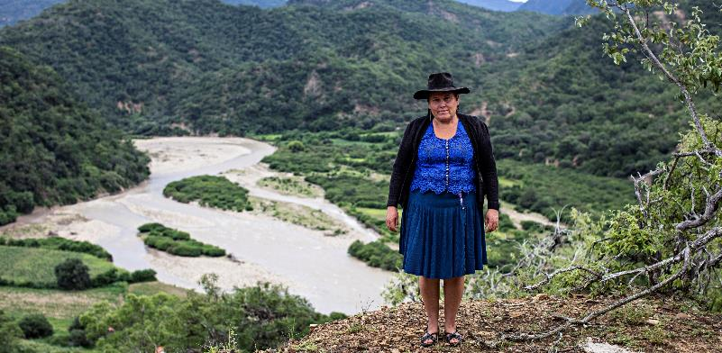
Achievements
The implementation of the Río Azero Watershed Management Plan has allowed to:
Harvest rainwater in tanks to better cope with droughts.
Improve irrigation efficiency to increase productivity and reduce water losses.
Reforest 1,000 hectares, securing water availability, and enhancing climate resilience and biodiversity conservation.
Work in a joint and participatory manner to ensure the sustainable management of water and natural resources.
Ana in the Azero river basin
Message from Ana:
“If we women put our minds to it, we can succeed in any field; but we must be determined; we cannot fall behind."
Let’s work together for our basin
Integrated rural development at river basin level (PROCUENCA), GIZ Bolivia, on behalf of BMZ.
Authors: Judith Vanessa Santander, Génesis Nava and Katerin Brieger. Photos: © Archive GIZ Bolivia PROCUENCA

Slide 7
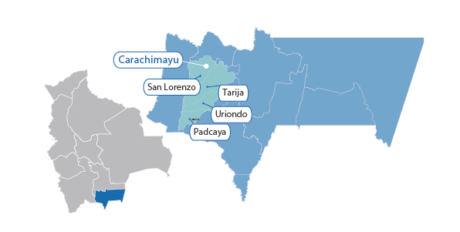
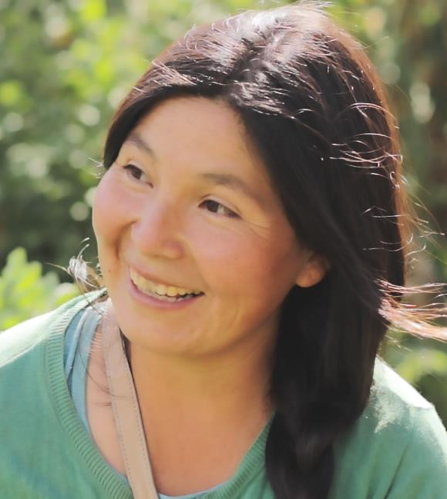
FRIENDLY CROPS
Trinidad Franco: Paving the Way for a Sustainable Environment
BOLIVIA
In light blue, the Guadalquivir watershed,
Tarija Department, Bolivia
Trinidad is a young farmer from the Carachimayu Norte community in the valleys of Tarija, in southern Bolivia. Since her childhood, she joined her father in agricultural activities, which have now become one of her main activities.
As she grew older, she sought training to improve crop cultivation and food production. She joined the Association for Development in Agroecological Zones (ADEZA), an organization of women agronomists in Tarija.

Slide 8
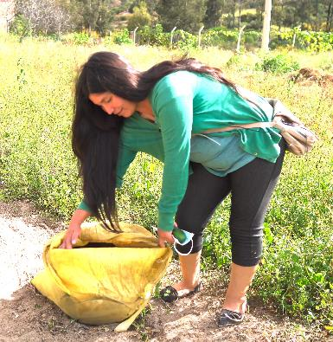
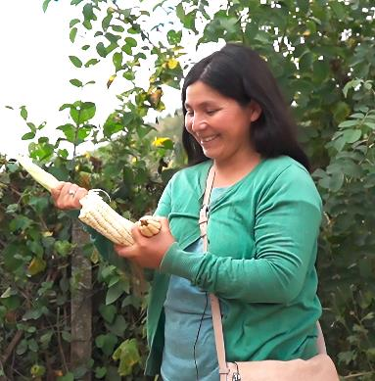
Motivationn
Context
Trinidad became interested in organic farming because she realized it was healthier and friendlier for the environment. When her father applied chemical fertilizers, she observed that the soil consistently hardened, earthworms died, and planting and harvesting became more challenging.
As soon as she started using macerates and organic fertilizers, not only did production improve, but soil also became softer. The waiting period between two harvests was shorter, and overall enhanced soil health increased crop yields.
Trinidad’s search to improve her farming practices led her to specialize and share her knowledge with her community.
The use of agrochemicals affects at least 4,500 families in the Guadalquivir watershed. These substances contaminate water resources, and their prolonged use reduces soil fertility and increases the time for the land to become arable again.
To improve watershed management, local communities promoted engagement in multi-stakeholder platforms and spaces for consultation and dialogue. These bodies promote projects that improve natural resource management with more efficient irrigation systems and environmentally friendly agriculture practices.
The project PROCUENCA (GIZ) promoted the consolidation of the interinstitutional platform in the Guadalquivir watershed.
Trinidad shows the fertilizer she produces and the results of her harvest.

Slide 9
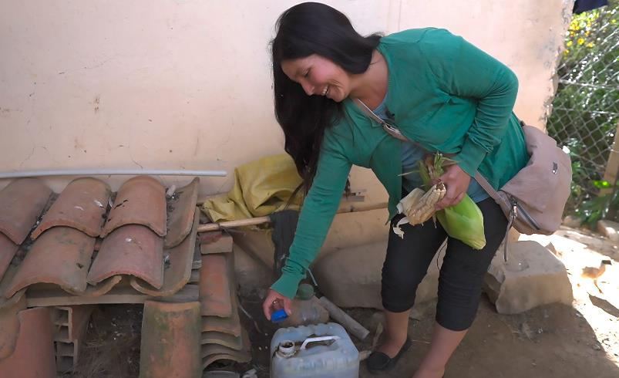
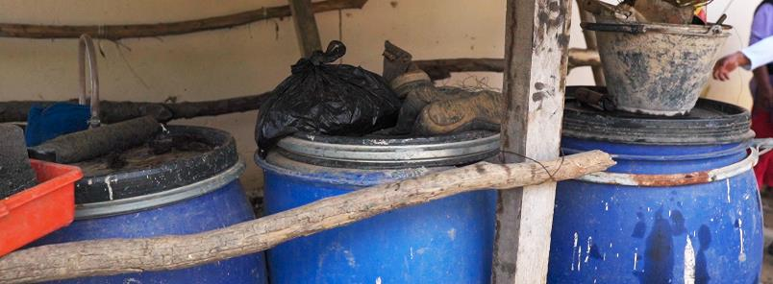
Actions
In 2005, Trinidad began making organic fertilizer and applying it to her crops.
The evidence of land reclamation motivated her to continue training.
She held community meetings, primarily for women, to teach the techniques of her preparation and organic methods.
The production of organic plant fertilizers has become a primary source of income for these women, enabling them to achieve economic independence.
As a member of ADEZA, in 2021, Trinidad became part of the multi-stakeholder platform of the Guadalquivir watershed.
Preparation of natural fertilizers
Organic fertilizer maceration
Notes:
.

Slide 10
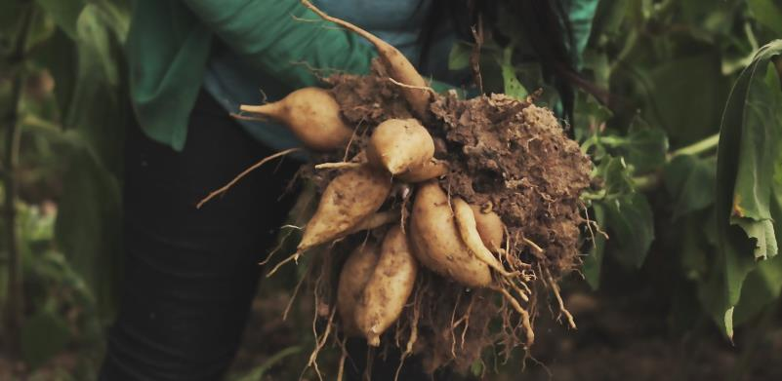
Achievements
Good agricultural practices and the use of bioinputs have increased environmental conservation.
Crop diversification has led to an increase in economic income.
Promotion of a group of women who are engaged in organic farming.
Fostering local female leadership.
The community participates in the management and use of natural resources at the watershed level.
Harvesting yacón, a root vegetable with a crunchy texture and sweet flavor.
Message from Trinidad:
“It has taken me many years to recover the land; now I like organic farming because it is a healthy production, environmentally friendly, and the products are sweeter.”
Women of the Guadalquivir River Basin– Buenas prácticas
Good Practices and Lessons - PROCUENCA (bivica.org)
Integrated rural development at river basin level (PROCUENCA), GIZ Bolivia, on behalf of BMZ.
Authors: Judith Vanessa Santander, Génesis Nava and Katerin Brieger. Photos: © Archive GIZ Bolivia PROCUENCA

Slide 11
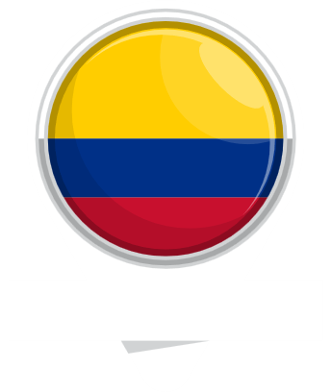
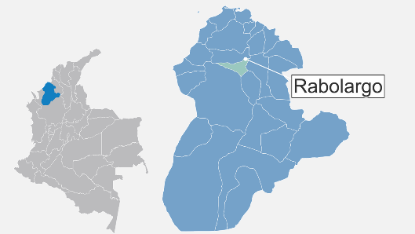
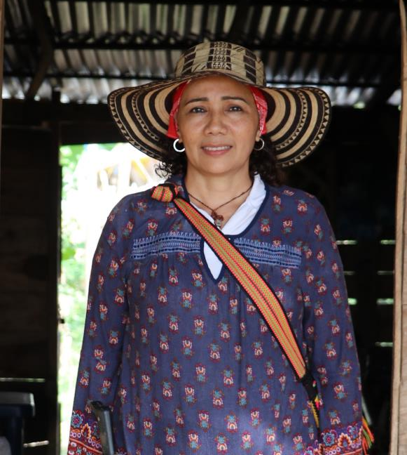
SEEDING CHANGE
Delma Díaz: a Transformative Leadership for the Women of Cereté
COLOMBIA
In light blue, the Córdoba Department,
Colombia
Delma lives in the community of Rabolargo, Cereté municipality, Córdoba department, in northern Colombia.
She is a leader who transformed her community by bringing 50 women together and founding the Association of Enterprising Farmer Women of Rabolargo, AMCER (2020, during the global pandemic). AMCER focuses on harnessing local produce and offering new opportunities to women through sustainable corn cultivation. This has empowered them and strengthened the regional economy.

Slide 12
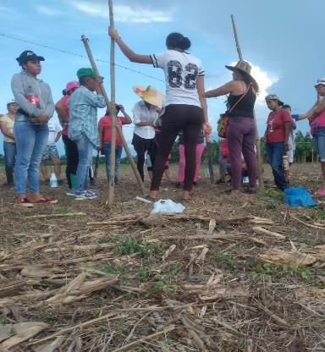
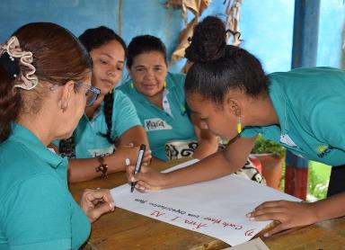
Motivation
Context
As a member of ASUCAR (Association of farmer users of Rabolargo), Delma participated in the ProNDC (Program to support compliance with climate targets). This has enabled her to better understand climate change and to improve her own agricultural practices, adapting her crops and productive practices to new climatic conditions.
“Women have different needs than men in terms of climate change adaptation and mitigation actions. That's why we have decided to organize ourselves as AMCER and participate in the ProNDC, based on our unique perspectives and contributions as women.”
They have faced many challenges, such as lack of land access, parallel domestic responsibilities, and male dominance within the agricultural sector. Both community support and the program itself have made it possible to overcome those challenges and become actively involved in climate initiatives, strengthening women's leadership.
Cereté and other parts of the Colombian Caribbean are marked by armed conflict and displacement. Moreover, there were significant transformations due to the expansion of livestock farming, which increased deforestation and affected soil quality. Due to climate change, rains and droughts have worsened, and corn, a pillar of the local economy, is part of a value chain that generates greenhouse gases (GHG).
To recover the Playón Comunal, El Vichal's wetland, the state granted Rabolargo's community 200 hectares for production and 62 hectares for conservation. Upon receiving these and set to addressing lack of food during the pandemic, the women of AMCER decided to recover traditional crops and use sustainable practices for soil protection, preventing erosion, and reducing GHG emissions.
AMCER in cowpea harvest
Planning activities together with women is key to strengthening the organization.

Slide 13
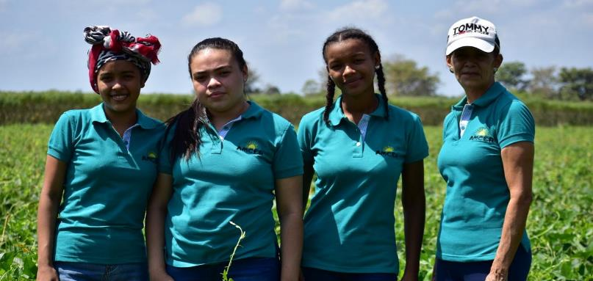
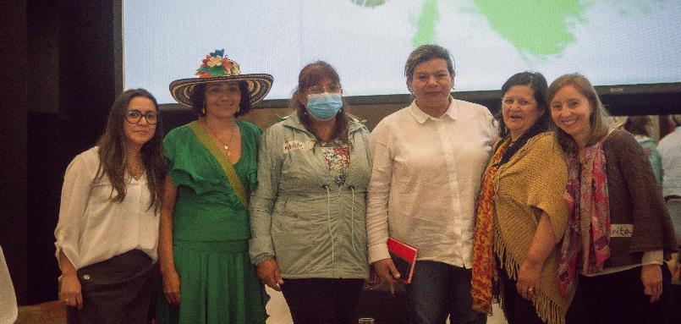
Role
Delma not only led the group of 50 women of different ages and various roles, but she also sought the support of unions, the government, the National Learning Service (aimed at technical training for adults), and other entities, thus expanding the scope and impact of her original project.
“Delmas leadership at AMCER was crucial in integrating the gender perspective into the ProNDC. Her determination turned the process into a pilot for the National Gender and Climate Change Plan, demonstrating how rural women effectively implement climate adaptation and mitigation actions.”
Marcela Rodríguez Salguero (ProNDC)
Women of different ages and roles are part of AMCER

Slide 14
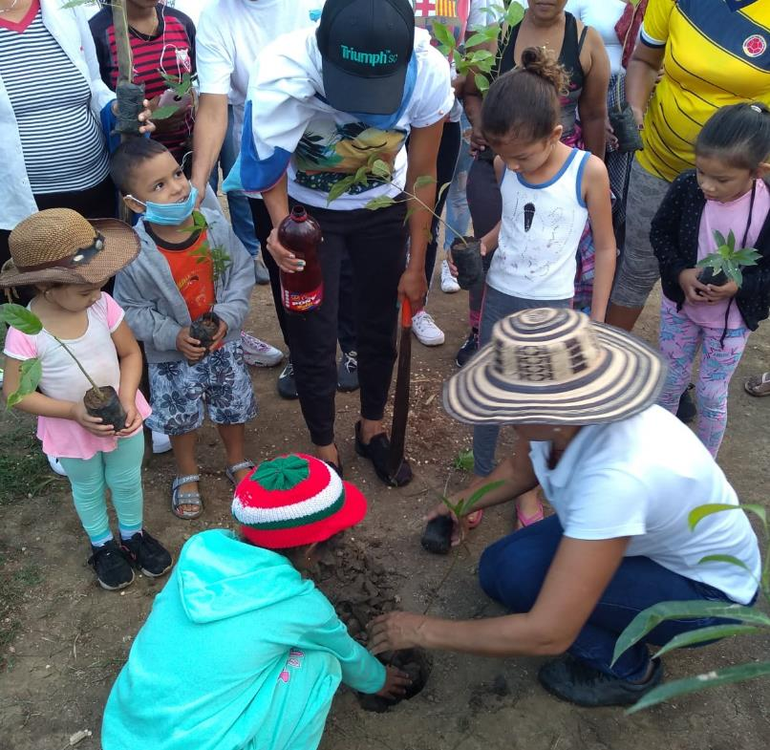
Actions
AMCER has identified, planned, and implemented both adaptation and mitigation measures:
Strengthening understanding of climate change in rural areas and its differential impact on women and girls given their roles and socioeconomic circumstances.
Methodologies and tools to comprehend climate information and its impact on crops.
Workshops focusing on the application of low-impact biofertilizers, enhancing tillage methods, and rotating corn with cowpea
Organizational strengthening addressing administrative, technical, and communication issues, as well as exploring various options for service provision.
Support and input for the construction of the National Gender and Climate Change Plan, based on their experiences and achievements.
More information here
Delma promotes the participation of children to generate processes of appropriation and recovery of traditional knowledge.

Slide 15
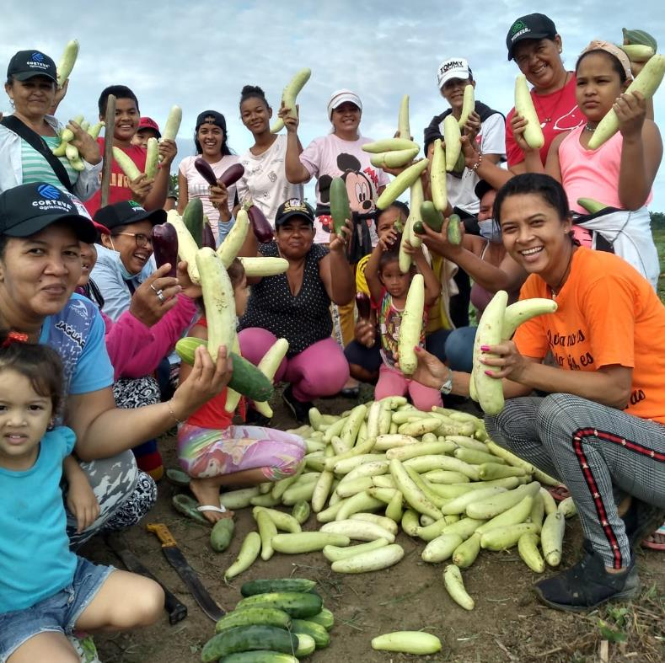
Achievements
Successful sustainable practices in the corn productive chain improved the soil's resilience to climate change and reduced the overall environmental impact.
Crops quantity and quality short-term increase, showing effectiveness of climate change adaptation measures.
Strengthening AMCER, empowering women to act on climate challenges from their roles as caregivers, managers, cultivators, and multiplier.
Youth participation and training in land conservation have increased.
In 2024, AMCER established its own brand to market its products.
AMCER has been able to join new GIZ projects (2024-2025), thus strengthening its sustainability.
Pumpkin is one of the products that allows for year-round harvests; when combined
with corn and beans, it provides resources for your food supply.

Slide 16
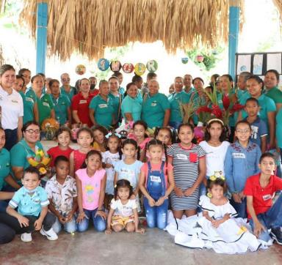
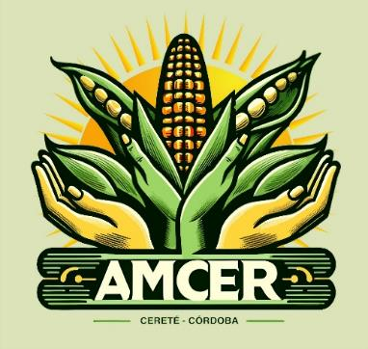
Lessons learned
Contexto
Message from Delma:
Women are essential to the success of projects. Participatory planning ensures that measures are effective and sustainable. Integrating local processes into policy formulation ensures that policies are more relevant and strategic, considering the diverse realities across the territory and the country itself.
.
“Let's believe in our strength and capability when we truly want something. Yes, we can change our way of seeing things. United, we can achieve everything, even what we thought was impossible.
By working properly and involving our community, we can rescue our nature—the one we grew up with, and that made us dream of playing in the rain and watching the sunset.
Fighting climate change is worth it, especially with the support of projects like ProNDC that truly believe in us.”
Girls, boys, and young people participate and are trained in the conservation of the territory.
ProNDC project, GIZ Colombia, on behalf of BMUV funded by IKI
Authors: Marcela Rodríguez Salguero & Laura María García
Fotos: ©GIZ Colombia / Marcela Rodríguez / Brayan Espitia
Logo of the Brand created by AMCER

Slide 17


From the field for policy making
Nelly Antonia Velandia: Uniting the Voices of Rural Women for a Sustainable Future
COLOMBIA
In blue, the Bocoyá department,
Colombia
Nelly lives in the municipality of Nuevo Colón in the department of Boyacá, Colombia.
She studied social sciences at the Universidad Distrital and has more than 30 years of experience defending the rights of women farmers through the National Association of Peasant, Black, and Indigenous Women (ANMUCIC), a non-profit trade union and gender organization that aims to improve the quality of life for rural women. She has served as president since 2016.

Slide 18


Motivation
Context
Nelly found her motivation to fight climate change after facing devastating crop losses and health problems. Experiences such as a hailstorm that wiped out her annual fruit harvest, a frost that destroyed hectares of potato crops, and a heat stroke that caused her to develop pre-cancer led her to realize that her story reflected that of many women in her community and in the country's fields.
Through her leadership in ANMUCIC, she unites the diverse voices of women in Colombia to shape climate change and biodiversity policies.
The Boyacá region has been suffering the ravages of climate change for years: sudden hailstorms, severe frosts, and intense sunshine that devastate crops and affect the health of people in the countryside. The lack of rural women's participation in environmental and agricultural policy decision-making processes exacerbates the effects.
When Nelly joined ANMUCIC in the 1980s, women faced systemic discrimination in land ownership. For instance, the exclusive granting of land titles to men left women vulnerable, particularly in situations of separation or widowhood.
Nelly then understood that it was urgent to promote actions against climate change, seeking not only to mitigate its impacts but also to empower rural women while doing so.
Nelly and other women leaders sharing their experiences during the construction of Colombia's Gender and Climate Change Action Plan.

Slide 19

Actions
Nelly was responsible for the planning and execution of both virtual and face-to-face regional dialogues with various women's organizations and associations, including both indigenous and non-indigenous, afro-descendant, fisherwomen, and peasant women, among others.
Provide inputs for Colombia's Gender and Climate Change Action Plan (2020). 350 women leaders actively participated, representing over 35,000 women, collaborating with the Ministry of Environment, and receiving backing from GIZ and UNDP.
Introduce a gender perspective in Colombia's Biodiversity Action Plan (2024). This involved the direct participation of 500 women leaders and 50 women's organizations, representing over 50,000 women, and was developed in coordination with the Ministry of Environment, with support from GIZ, UNDP, and Fundación Natura.
Nelly and other women leaders sharing experiences during the
process of updating the Biodiversity Action Plan (2024)

Slide 20


Achievements
Capacity building: within exchange spaces, leadership skills were strengthened, and proposals were generated to respond to climate change and enhance biodiversity conservation.
Full and effective participation: The promotion of women's active participation led to a deeper comprehension of their role in biodiversity conservation.
Integrated territorial diversity: experiences unification and articulation while also integrating the needs of women from different regions.
The impact on public policies directly influences the formulation of national policies on gender, climate change, and biodiversity.
Strengthening grassroots organizations.
Climate Dialogues Document, Gender and Climate Change Action Plan, Colombia (2020)
Mesage from Nelly:
"It is important to recognize the different realities and commitments of women from the territories." Understanding these realities strengthens our advocacy efforts and enables us to develop plans with a distinct and territorial focus. It is crucial for the country to have this opportunity to reach those who are most in need—those who are suffering due to the impacts of climate change. The invitation is to continue working together.”
ProNDC & Interface program, GIZ Colombia, on behalf of BMUV funded by IKI Authors: Laura María García & Marcela Rodríguez. Fotos: ©GIZ Colombia / Laura García

Slide 21



WATER PROTECTOR
Roxelia Vargas Vargas and the Suerre ASADA, a Successful Partnership for Water Security
COSTA RICA
In light blue, the Pococí county,
Limón, Costa Rica
Roxelia lives in Pococí, a rural county in the province of Limón, Costa Rica.
Since arriving there in 2010, she has worked with outstanding dedication at the Administrating Association of Sewers and Aqueducts (ASADA) Suerre, where she is the current administrator.
She has helped improve the ASADA's integrated water resources management through promoting sustainable finance for potable water services, aquifer recharge, and source water protection zones to increase water security in the Suerre community.

Slide 22


Motivation
Context
Climate change affects the Pococí county, causing floods, landslides, droughts, and strong heat waves. Periods of droughts and high agricultural water demand pose challenges to securing water supply for several communities, including Suerre.
Roxelia, one of the leaders of the ASADA today, understands the importance of preventing extreme events form occurring more frequently. Therefore, she promotes training and improvement plans for the aqueduct structures to ensure a sustained water supply and avoid service interruptions.
One of Roxelia’s biggest motivations is to make a meaningful difference in her community and in people's lives.
“I like to motivate people who want to go the extra mile and who can offer things to support the community.”
She approached the ASADA for support in financial management and, over time, helped strengthen its operation. This led her to discover the potential of community-led aqueducts in encouraging participation in integrated water resources management and achieving better results.
She also contributed her experience on the Board of Directors, gaining knowledge about topics such as source water, infrastructure needs, and coping with climate change. Thus began her fight for the environment, cultural development, and water security.
Roxelia working with the Suerre community.

Slide 23

Actions
The ASADA established partnerships with environmental education schools and universities to draw in volunteers, technologies, and innovation.
The ASADA's team is trained on sustainable financial management.
Community collaboration and partnerships for initiatives like reforestation, safeguarding springs and water recharge areas, restoring wetland ecosystems, cleaning up rivers, and managing solid waste, among other things.
Roxelia shared her knowledge with other community water managers and promoted the active participation of women, making their voices heard and having a presence in decision-making within their communities.
Roxelia in the Suerre ASADA erre

Slide 24

Achievements
The ASADA has formulated Water Safety Plans and secured funds for source water protection to supply the 5,600 people in the community and even reach other communities in case of need.
Suerre has implemented storage tanks to reduce water service interruptions.
A weather station has been installed in the community for climate monitoring.
The ASADA has strengthened its team's capacities, particularly in financial management, and now has its own building.
Community resilience to hazards such as droughts and floods has increased.
Collaborating on the Buenos Aires aqueduct risk plan
Message from Roxelia:
“I tell women that they have to approach participation spaces and accompany the actions of the community. It is an opportunity to demonstrate women's potential and competences.
We think we are not ready, but we must not give up; we must work and generate confidence to make ourselves known and achieve a space. To be authentic, because with who we are, we have the capacity to show the good things we can do.”
Regional project Scaling-up ecosystem-based adaptation in rural Latin America (EbALAC), GIZ Costa Rica, on behalf of BMUV funded by IKI
Authors: Astrid Michels & Diana Ramírez. Photos: © GIZ Costa Rica EbALAC / Adriana Campos & © Asada Suerre

Slide 25


HEROINE OF THE SEA
Silvia Campos: with Commitment in her Blood and the Gulf in her Heart
COSTA RICA
In green, Chira Island, in blue the Gulf of Nicoya Costa Rica
Silvia was born on Chira Island, in the Gulf of Nicoya—one of Costa Rica's largest estuaries and most vital artisanal fishing areas. A recognized leader, she is the founder of the Women's Association "Save the Gulf of Nicoya" and a dedicated protector of the region's marine fishing areas. Silvia embodies pure commitment and conviction, teaching these values by example for 18 years. She is also the treasurer of the Board of Directors for the Local Fishermen's Committee of Puerto Níspero.

Slide 26


Motivation
Context
Since the 1990s, overfishing for the international market has increased significantly.
Climate change is manifesting in the Gulf of Nicoya through rising water temperatures, increased wave activity, coastal erosion, loss of coastal marine habitats, and a projected decline in productivity.
Land use changes have led to the contamination of the gulf with wastewater and agrochemicals, mangrove deforestation, ecosystem degradation, declining fish stocks, and affecting the available natural resources on which many coastal families depend, resulting in poverty and unemployment in the community.
Raised in a family of fishermen, Silvia gained firsthand experience and understanding of the difficult situation faced by artisanal fishermen and women in the area, particularly the overexploitation of the Gulf of Nicoya due to illegal and poorly regulated fishing practices that have resulted in the disappearance of many species. Her goal is to restore the Gulf of Nicoya and its fishing.
“I want to return to the way things were before. I come from a fishing family and have been going fishing since I was a child.
I ask myself, What are we going to leave for future generations?
We must do something now; that is my motivation and my commitment.”
Impressions from the Gulf of Nicoya

Slide 27

Actions
Silvia founded the Women's Association "Save the Gulf of Nicoya," which protects the area.
She fought to ensure the culture and well-being of artisanal fishermen in the Gulf of Nicoya.
She united more people to conserve biodiversity and protect coastal marine ecosystems.
She participated in planning processes for the sustainable management of coastal resources in the Gulf of Nicoya.
Fishers in the Gulf of Nicoya

Slide 28

Achievement
Public awareness of the significance of preserving marine-coastal ecosystems and restoring mangroves for the welfare of fishing communities and marine biodiversity has grown.
Artisanal fishing communities are adopting more sustainable and environmentally responsible fishing practices.
Women's groups and fishing communities are working to protect the Gulf of Nicoya from illegal fishing.
Mangroves in the Gulf of Nicoya
Mensaje de Silvia:
“There are already many women working, but we need more spaces for women's involvement.
I would tell women not to be afraid and to fight for their convictions, no matter if it is exhausting or difficult. It has brought me harsh blows and animosities within the community, it has been worthwhile. If we don't take care of the Gulf and implement responsible practices, things will not improve.”
Regional Program Saving the Blue Five, GIZ Costa Rica & MarViva, on behalf of BMUV funded by IKI
Authors: @MarViva & Astrid Michels. Fotos: © MarViva

Slide 29



SHUAR WOMEN PRESERVING THEIR CULTURE AND FOREST
Tarcila Ankuash Shacay: Getting more Women to Protect the Forest
ECUADOR
In light blue, the province of Morona Santiago
Ecuador
Tarcila belongs to the Shuar People of the Ecuadorian Amazon. She is a farmer and lives in the “Kutuku Shaimi” protected forest in the south-central Morona Santiago Province.
She has been part of the Tsapau Association since 2022, where she is a leader in the rescue and preservation of traditional knowledge, and she also works on subsistence agriculture.
She is a mother of six sons and daughters and devotes herself to her association, the community, and her Aja (home garden).
Más información aquí

Slide 30


Motivation
Context
In Shuar culture, thanks to our knowledge and traditions, we grow in harmony with nature, and our cosmovision is and will remain our strength. However, adjusting to a globalized life has been difficult, as the introduction of trends and practices has led to the loss of our cultural identity. For instance, we have adopted agrochemicals that harm our Mother Nature and our health.
One reality within the association was that women leaders didn’t have spaces for participation, and there was a lack of organization regarding roles and responsibilities. This motivated me to do what I do.
The Shuars economic division of labor usually involves women caring for and maintaining the home garden, or Aja, and growing vegetables, fruits, and medicinal plants. Climate change and agricultural land fragmentation have affected the Aja and women for a few years.
Furthermore, government support is typically given directly to the community representative without considering the views and experiences of women, and it almost always consists of agrochemicals and ‘improved’ seeds—not the organic products we use to care for our gardens.
With the technical assistance of the BioValor program, Tarcila and other women from the community identified obstacles. They committed to a project that would support pollinators, endemic plant nurseries, forest structure, and, above all, strengthen the capacities of women and young people to revitalize the soil and achieve sustainable production.
Tarcila and her husband, during an ancestral fishery activity

Slide 31

Actions
In 2022, Tsapau and GIZ collaborated on a change project that focused on value chains, emphasizing the critical role and knowledge of women. Women determined the training session topics, approaches, and timetables based on their needs during the planning stage.
Through its program, Tsapau encourages women, young people, and elders to participate and take on leadership roles.
The Tsapau team participates in training sessions covering topics such as communication, sustainable production, governance, and more.
Tsapau receives support to participate in international trade fairs and business networking events with their products and proposals.
Regarding cultural identity, Tarcila encourages the Shuar language's revival through songs (Anents) and the traditional agricultural systems of Aja.
Tarcila collecting Aja's produce

Slide 32


Achievements
Women's productive role is being revalued, particularly in value chains that originate from the forest and the Aja.
Tsapau is renowned for its women-led work model that diversifies sources of income.
Tsapau operates with a living soil model and has a biofactory for organic fertilizer that provides the nutrients.
The national and local governments have stopped distributing agrochemicals and are supporting the biofactory in the production of fertilizers.
Tsapau has become a training center even for nearby communities.
Based on their model, they have secured two new sources of funding in the past year.
Tarcila exponiendo la importancia del Aja en un intercambio de mujeres
Tarcila showing the importance of the Aja in a women's knowledge exchange event
Message from Tarcila:
“There is a place where women’s leadership is unquestioned: their garden, known as the Aja, a space where women breathe, connect, and give thanks to their deities, especially Nunkui (Mother Nature).
I will continue to motivate more women to engage in agroforestry activities because caring for nature and producing sustainably brings us harmony.”
Sustainable Utilisation of Biodiversity in the Amazon and Coastal Regions (BioValor),GIZ Ecuador, on behalf of BMZ
Authors: Luis Arévalo & Jacqueline Fierro. Fotos: © GIZ Ecuador / Rafael Jarrin

Slide 33


FOR EQUALITY AND CONSERVATION
María Florencia Pichisaca Pichazaca: Bringing together Women’s Rights and Environmental Protection
ECUADOR
In light blue, the Cañar province in
Ecuador
My name is Florencia, and I am 34 years old. I am Cañari, from the province of Cañar in southern Ecuador. I live in the Quilloac community with my mother and daughter, and I hold a degree in Nutrition.
Currently, I am the president of TUCAYTA, an Indigenous and peasant organization that aims to promote rural development with identity, embracing a pluralistic and intercultural approach.
More information here.

Slide 34

Motivation
Context
My inspiration to lead initiatives in TUCAYTA stems from living alongside my mother and daughter, three generations of women who have demonstrated that it is possible to break stereotypes and achieve greater levels of participation.
What motivates me is creating change in my community through justice, peace, and sustainable development, ensuring that all decisions include women’s voices and protect our natural environment. To this end, I want to promote community projects, such as improving the irrigation system of Patococha Lagoon, our main water source.
In my community, women face significant challenges, such as lack of representation in organizational decisions and political discrimination. Over the years, I have worked alongside other women to reduce inequalities and create a more equitable environment. My fight focuses on gender equality and environmental protection.
In Quilloac and other communities, biodiversity loss and moor degradation have severely affected water availability and impacted our food security. Unsustainable agricultural practices, like the excessive use of pesticides and other chemicals, have worsened the situation. These environmental issues are inseparable from our struggle for equality, as they directly impact our quality of life.
Empowerment of women to face challenges

Slide 35

Actions
Land acquisition: I led the purchase of land to expand conservation areas and protect water resources, reducing animal pressure through voluntary agreements.
Moor protection: We implemented barbed wire fences with recycled posts to prevent livestock access, with support from the Mountains Program (GIZ) and our own resources.
Community mingas: We organized mingas on weekends, actively involving women from the community in environmental protection. This provided a space for participation and introduced a new concept to many.
Infrastructure: Investments were made to modernize the irrigation system and support the management of water resources.
Lead ecosystem conservation actions in the field

Slide 36

Achievements
The most significant achievement for me was becoming the first female president of TUCAYTA in the organization’s 40-year history. We work for the well-being of the 8,300 inhabitants within our jurisdiction, across 15 communities, and with 4 agricultural production cooperatives.
I broke stereotypes and implemented a management model focused on Mother Earth and environmental protection, contributing to peace and progress in our community.
We succeeded in raising environmental awareness by acquiring land in moorland areas, which increased water availability, natural resources, and protected lands for the entire community.
First woman president of TUKUY CAÑARIS AYLLUKUNAPA TANTANAKUY-TUCAYTA, which means: Corporation of Cañaris Indigenous and Peasant Organizations
Message from María Florencia:
“To the women of my homeland and the world, I say that changing environmental awareness is not easy, and we cannot do it alone. We must start by improving ourselves and then come together to face the challenges that threaten our planet. We can't do nothing while the Earth is being destroyed.
Anything is possible when one is determined. I hope I have shared my experience from the cradle of Cañari identity, one of the many nations that make up the diversity of Ecuador. I send you a warm embrace of encouragement and affirm that yes, it can be done.”
Restoring mountain ecosystems in the Andes, GIZ Ecuador, on behalf of BMZ
Author: Andrés Pomboza. Fotos: © GIZ Ecuador Programa Montañas

Slide 37


FINANCIAL INCLUSION FOR COMMUNITY DEVELOPMENT
NITARIO
Ligia Sánchez Zambrano: Training Women and Young People in Resilient Finance and Entrepreneurship
ECUADOR
In light blue, Portoviejo county
from the Manabí Province, Ecuador
Ligia lives in Portoviejo, the capital of Manabí province, Ecuador. She is an administrator and works as a trainer at FUNDER (Fundación Educativa Monseñor Cándido Rada).
As a key part of FUNDER's mission, Ligia provides training on finance and resilient entrepreneurship to vulnerable populations, especially young people and women who did not have access to formal education, to help them gain better economic and social opportunities and participate in the development and transformation of their communities.

Slide 38

Motivation
Context
From a young age, Ligia witnessed changes in her province: rapid urbanization, rural migration, deforestation, and the loss of water resources. Later, she observed that the knowledge gap and lack of property rights hindered women’s access to financial resources and limited their ability to develop their own enterprises. She understood that women are more vulnerable to climate change.
She decided to provide training processes aimed at empowering women through sessions on the proper management of financial resources, climate change adaptation actions, and programs for agroecological production and sustainable land use. Ligia firmly believes that women’s actions will promote rural resilience and bring about significant improvements.
In Portoviejo, climate change is evident in recurring droughts and flooding cycles affecting agricultural activities, such as maize and cocoa production and livestock farming. Additionally, inadequate land management practices and agricultural expansion through deforestation have degraded wetlands and caused significant harm to nature.
“The greatest impact is rural, where resources like water, land, and the lungs of the planet are, which ensure food security for everyone.”
There is a need for sustainable natural and economic resource management and an understanding of the benefits of biodiversity protection.
In one of their daily foraging activities in the forest, a rural woman from Manabí, the mother and head of the family, is accompanied by her son.

Slide 39

Actions
Economic empowerment: programs on financial education highlighting the significance of saving, and financial planning for resilient and green enterprises, with a focus on women's participation and leadership.
Responsible investment with a commitment to environmental stewardship.
Training on the effects of climate change on the financial status of rural communities, the significance of sustainable activities, and the processes of adaptation in these situations.
Advising rural communities on the formation and operation of community saving groups, empowering women and youth to decide on saving and executing climate change adaptation strategies within their community.
Members from three local communities located in the northern landscape of the EbA LAC intervention area in Manabí are strengthening their associative efforts.

Slide 40

Achievements
160 families from various communities in the EbA LAC intervention area in Manabí have improved their economic management and well-being by enhancing their saving habits and investment in their family farms.
Over 650 people will benefit from the establishment of eight community savings groups to address climate change emergencies in the community.
Three community tree nurseries have strengthened their socio-organizational and financial management, improving production and food security for families.
Rural women receive training certificates in community savings
Message from Ligia:
"Women and youth, prepare yourselves and seize the opportunities. Seek out spaces; know that knowledge is power. In your daily and productive activities, as leaders or in other roles, women with knowledge bring continuous improvements for themselves and their surroundings. Be the source and guide of what happens and lead the way forward.”
Regional project Scaling-up ecosystem-based adaptation in rural Latin America (EbALAC), GIZ Ecuador on behalf of BMUV funded by IKI
Authors: Alexandra Vásquez, Carla Gavilanes, Erik Camelos. Fotos: © GIZ Ecuador EbALAC

Slide 41



RESCUING BIODIVERSITY WITH ANCESTRAL TRADITIONS AND SUSTAINABLE INNOVATIONS
María María Cristina Par Tuluxan: Leading Changes in a Quiché Community
GUATEMALA
In light blue, the municipality of Santa Cruz de Quiché
Department of Quiché, Guatemala
María Cristina is a Mayan quiché farmer from the municipality of Santa Cruz de Quiché, Guatemala. She is 39 years old and has four children. Her passion for learning led her to find training in sustainable agricultural practices, combining this knowledge with what she inherited from her ancestors, and eventually becoming a promoter in her community.
She has carried out this work with organizations such as the Rural Development Learning Center (CADER), the Municipal Commission for Food and Nutrition Security (COMUSAN), and the Municipal Office for Women (DMM).

Slide 42

Motivation
Context
In the face of rising prices for the basic food basket, caused by frequent droughts in the last 10 years, Ma. Cristina set out to overcome the economic challenges and did so from a special place: caring for the land and improving production.
With the support of the Ministry of Agriculture, Livestock, and Food, she learned about the importance of using available resources and adapting her production methods. This led her to revalue Ütz Ab’ix (good milpa)—an ancestral system that shares characteristics of agroforestry and uses local biodiversity—and combine it with sustainable technological innovations. Seeing improvements in soil conservation and native species, she decided to dedicate herself to sharing her knowledge.
Santa Cruz de Quiché, as part of the so-called "Central American Dry Corridor," experiences prolonged drought periods that reduce agricultural production, especially of staple crops like maize and beans, which are essential to the local diet.
The impact of climate change and biodiversity loss aggravates the situation and is reflected in the disappearance of medicinal plants and various food sources in the community.
These situations affect, above all, Quiché women because of their responsibilities for subsistence agriculture, food security, and family care.
Ma. Cristina Par Tuluxan offering some of her products to the community

Slide 43


Actions
Since 2012, Cristina has led trainings for 60 women dedicated to facing the challenges of climate change by improving their agricultural practices.
Adaptation and environmental protection strategies, such as preparing organic fertilizers, composting crop residues, and selecting the best seeds for more resilient crop cycles.
Ecological restoration with elderberry sprouts in cornfields.
Installation of handmade drip irrigation systems using recycled plastic bottles.
Implementation of windbreaks and irrigation channels to manage water use, protect crops, reduce erosion, and promote crop growth.
Ma. Cristina in training activities

Slide 44

Achievements
Women of the community implement sustainable agricultural practices, market the organic products they grow in nearby markets, and have access to food and medicinal plants all year round.
Resilience and production levels of organic crops have improved through the combination of sustainable agricultural techniques with ancestral knowledge.
Crop diversification and marketing initiatives have improved local economic development.
Cristina’s plot serves as a demonstration center and promotes the experience exchange.
Ma. Cristina Par Tuluxan
Message from María Cristina:
"As a promoter, I encourage other women in Guatemala and across Latin America to persevere and get involved in biodiversity restoration and the fight against climate change.
I tell them that it is possible, even if there are barriers and diverse climates. Despite the challenges, there is a future if we work with effort and determination."
Regional project Scaling-up ecosystem-based adaptation in rural Latin America (EbALAC), GIZ Guatemala, on behalf of BMUV funded by IKI
Authors: Maricela Méndez & Sharon van Tuylen. Fotos: © Maricela Méndez y © GIZ Guatemala EbALAC / Neftalí Calel

Slide 45



WATER HARVESTING FOR THE SEMI-DESERT
SEMIDESIERTO
Ana Paola Rangel: a Young Leader Making Changes in Guanajuato
MÉXICO
In light blue the Guanajuato State,
México
Ana Paola was born, grew up, and now works surrounded by nature in the rural farming and fishing community of Presa de Jesús María, in the municipality of San Felipe, Guanajuato, Mexico.
She is 28 years old and the first in her family and community to attend university, graduating with a degree in Forestry Engineering.
Ana Paola is an environmental promoter and educator for projects focused on nature-based solutions adaptation, primarily training youth and children in bird and wildlife monitoring through Art-Nature.

Slide 46


Motivation
Context
Ana Paola is a skilled and observant woman. She has always been aware of the environmental changes occurring around her, such as drastic temperature changes, water shortages, and vegetation loss. These concerns motivated her to pursue studies that would enable her to contribute with knowledge and find sustainable solutions to improve habitats and communities. Her professional preparation has inspired other young people to continue their education.
In the region, extreme droughts and reduced water levels have affected wetlands, springs, and aquifers, along with more frequent pests and forest fires, overgrazing, deforestation, and natural resource extraction. Overall, this has led to soil erosion and compaction, resulting in vegetation loss and negative impacts on agricultural production.
For these reasons, Ana Paola became involved in implementing solutions related to soil, water, and biodiversity conservation.
Environmental Education Arte Naturaleza in primary school Natural Protected Area Peña Alta

Slide 47

Actions
To address water scarcity, in 2019, Ana Paola began collaborating with Salvemos al Río Laja A.C. Together, they joined the ADAPTUR (GIZ) project. She trained and participated in designing ecosystem-based adaptation (EbA) measures for the communities of Puerto Nieto and Agustín González in the Municipality of San Miguel de Allende.
In 2020 and 2022, she coordinated the design and implementation of EbA measures with the communities, including soil conservation practices to improve water infiltration and reforestation with native plant species.
Today, she continues working with these communities and is a member of the technical committee of the Peña Alta Protected Natural Area, where decisions are made on natural resource conservation..
Paola reforesting with native plants

Slide 48

Achievements
In the Agustín González & Puerto Nieto communities:
Residents acquired knowledge and have continued implementing solutions to their problems beyond the project.
80 hectares have been improved with soil conservation and water infiltration works, including terracing, trenches, dams, and stone cordons.
Reforestation with 15,000 native plants including maguey, nopal, ocotillo, and others.
Walls made of stone that store and filter water
Message from Ana Paola:
“Working for the communities and schools, I have realized that the actions and follow-ups that we have promoted have been successful and are a form of adaptation for the residents.”
Adaptation to climate change in the tourism sector (ADAPTUR), GIZ México, on behalf of BMUV funded by IKI
Authors: Daniela Valera Aguilar, GIZ. Fotos: © Ana Paola Rangel Romero & Agustín Madrigal Bulnes
Notes:
walls made of stone that store and filter water

Slide 49


RESTORING OUR RIVERS
Perseida Tenorio Toledo: Promoting Ecotechnologies in Oaxaca
MÉXICO
In light blue, the Tehuantepec isthmus,
Oaxaca State, México
Perseida is 31 years old and Zapotec, from the Isthmus of Tehuantepec, Oaxaca, Mexico. In 2021, she founded the Traveling Water and Arts School, "El Corazón de la Tierra."
As an outstanding student and student leader, she received several scholarships: at the Tecnológico de Monterrey, Querétaro Campus, she trained as a Food Industry Engineer; at the University of Buenos Aires (Argentina), she specialized in fruit and vegetable production and post-harvest; and in Ecuador, she visited various initiatives and learned about water ecotechnologies.

Slide 50

Motivation
Context
Perseida’s inspiration comes from her culture. Zapotec women are highly creative and have outstanding problem-solving abilities, using arts, flowers, and the wind in their relationship with nature.
Despite economic limitations, Perseida stood out for the socio-environmental programs she has designed or led. She emphasizes the importance of creating local solutions to climate change, focusing on pillars like ecopedagogy, youth, nature, and women.
The initiative began as a solution for her village, but she is determined to expand the school's outreach to restore rivers in rural communities throughout Latin America, with the ultimate goal of enabling young people to stay in their communities without the need to migrate.
The Zapotec communities settled on the banks of the Guigubicu River hundreds of years ago. Therefore, water, fishing, pottery, and other traditional crafts are integral parts of their culture. They installed a drainage system for the wastewater discharging into the river twenty years ago. Over the years, Perseida watched as the river died, along with most of the animals that inhabited it and the nearby plantations.
Megaprojects and the effects of climate change, such as alterations in rainfall, also affect the Isthmus of Tehuantepec, leading to prolonged droughts, elevated temperatures, and a rise in sea level in several coastal marine communities.
Perseida at the Niza wetland in Ixtepec, Oaxaca: a community project for the restoration of the Guigubicu River

Slide 51


Actions
Since 2017, she has promoted river restoration initiatives with a socio-environmental approach, organizing collectively with groups like Una Mano para Oaxaca, Tequio Niza Ya’, and female leaders in the area.
In 2021, she founded the Traveling Water and Arts School, where they design, adapt, and develop water ecotechnologies to eliminate grey water discharge into rivers.
She conducts training activities to prepare young people to replicate these ecotechnologies in their communities and to become multipliers.
Perseida has gained the support of organizations such as GIZ Mexico, Service for the World, and the global youth network ChangemakerXChange.
Biofilter workshop for grey water was conducted with youth from the Instituto Superior Intercultural Ayuuk in Jaltepec de Candayoc, Oaxaca
Perseida Tenorio and Guiebeu Ballesteros, coordinators of the Traveling Water and Arts School in Ixtepec, Oaxaca

Slide 52

Achievements
The Traveling School collaborates with organizations in Central America, and the team has expanded with young people from Colombia and Costa Rica.
Systems installed in Mexico, Guatemala, and Colombia prevented the discharge of over 200,000 liters of gray water into rivers each month.
After a year of operations, Perseida joined forces with biologist Guiebeu Ballesteros to strengthen and expand training for young people as environmental leaders in other regions.
The FAO recognized Perseida's "Mi Fruta, Mi Pueblo" program as a solution to end food waste in Latin America.
The Commission for Environmental Cooperation of North America awarded the school the Youth Innovation Award in 2023 for "Water Solutions" and acknowledged the school for tackling water issues in Mexico.
Participation of Perseida in the Trinational Forum of the Commission for Environmental Cooperation of North America, Victoria, Canada.
.
Message from Perseida:
“Being part of networks with other women or rural youth has been very enriching because we support each other, and it drives us to dream and create projects and solutions from our territories. Thanks to the networks we have built with social organizations, collectives, and educational centers, it is possible to have positive impact in other countries in Latin America.”
Promote innovations for sustainable food production (Vida y Campo), GIZ México, on behalf of BMZ
Authors: Perseida Tenorio & Vania Olmos Lau. Fotos: ©Escuela Itinerante de Agua y Artes

Slide 53



CRAFT THAT SHAPES A SUSTAINABLE FUTURE
Yolanda Osorio Yunca: Guardian of the Wetlands
PERÚ
In light blue, the Vegueta district,
Huaura province, Perú
Yolanda Osorio Yunca was born in Huacho and lives in the rural town of Medio Mundo, in the district of Vegueta, Huaura province—Huacho, north of Lima, Peru. Her father was a reed harvester, and her mother was a weaving artisan. Growing up with them allowed her to know and love the wetlands and the world of reeds.
Her successful venture in crafts is rooted in her past. Together with a group of artisans, she formed the Association of Women Artisans of Medio Mundo (AMARTEMM). Yolanda served as president for two terms, and now she is the secretary. Besides being an artisan, she is also a wife and mother of two.

Slide 54


Motivation
Context
Yolanda has a deep connection with nature. She views the ecosystem and the wetlands as feminine, even maternal, figures, providers of opportunities. This cosmovision supports the importance of protecting the wetland and implementing sustainable environmental practices.
This is where her motivation arises to participate and lead actions for the conservation of the Albufera de Medio Mundo wetland. She recognizes that a healthy wetland will provide reeds, which are the raw materials needed to continue producing the crafts that sustain her community.
Climate change has affected the coastal marine zone of Huaura and its wetlands. This has been evident in irregular fishing, abnormal waves, pests, pollution, and microclimate changes that have impacted reed growth, reduced water levels in the ponds, and brought strong winds that affect the lives of the artisans and reed harvesters who depend on these ecosystem services.
The local NGO CooperAcción, in partnership with the EbAMar project (GIZ), established the Women Artisans' School to enhance knowledge on climate change adaptation and wetland conservation, while also developing skills in reed weaving and craft sales. Yolanda is one of the master artisans at the school, where she contributes to the wetland conservation.
Artisans showcase baskets made from reed, a raw material harvested from the Albufera de Medio Mundo Wetland, located in Vegueta, Huaura, Lima Region, Peru.

Slide 55



Actions
At the Women Artisans' School, Yolanda teaches the art of weaving reed crafts based on three key concepts: ecosystem, weaving, and market.
Women learn to design, weave, and promote their traditional crafts. They also learn about climate change, its impacts on coastal marine ecosystems (such as wetlands), and resilient adaptation strategies. In this way, they generate their own income and contribute to wetlands conservation.
Every year on the anniversary of the creation of the Albufera de Medio Mundo Regional Conservation Area, AMARTEMM organizes wetland cleanup campaigns.
Yolanda and her colleagues train reed harvesters and raise awareness about the importance of respecting harvest seasons and implementing techniques that are friendly to the wetlands.
Artisans and reed harvesters protect and sustainably use the Albufera de Medio Mundo wetland.

Slide 56

Achievements
2019: AMARTEMM won first place at the national level in the "IX National Award for Peruvian Craft Design: Innovation in Crafts," awarded by Peru's Ministry of Foreign Trade and Tourism, recognizing their innovation, creativity, contribution to cultural identity, and sustainable development.
2023: AMARTEMM received the “Conservation Ally” Seal. Peru's National Service of Natural Protected Areas (SERNANP) granted them a license to use the “Conservation Ally” brand, acknowledging their responsible work in the sustainable use of reeds. With this recognition, AMARTEMM reinforces its commitment to wetland conservation and adds value to its products, which come from natural areas.
Yolanda with women artisans
Yolanda junto a mujeres artesanas
Message from Yolanda:
“I invite other women to learn from our reed crafts and see how this fiber conveys emotions: sadness and joy. For example, when we are happy, we use bright colors, but when we are sad, cooler colors. We express feelings through our work. That's why it is important to conserve the wetland, which is a source of life and, for us, a source of livelihood. While we work on it, we are also caring for it. We achieve this through cleanup campaigns and training sessions for harvesters on sustainable extraction. If we take good care of it, the wetland will return twice as much to us.”
Ecosystem-based adaptation measures protect coastal and marine areas in Peru (EbAMAR), GIZ Peru on behalf of BMUV funded by IKI
Authors: Rosa María Rodríguez Gómez-Cornejo, Maria Fernanda Mendoza Aguirre. Fotos: © GIZ ConoSur / Daniel Rojas

Slide 57


Acknowledgement
Regional Program: Scaling-Up Ecosystem-Based Adaptation Measures in Rural Latin America (EbA LAC)
The project is part of the International Climate Initiative (IKI). The Federal Ministry for the Environment, Nature Conservation, and Nuclear Safety (BMUV) supports this initiative based on a decision of the German Bundestag.
Series: True stories and tales inspired by women fighting against the effects of Climate Change and Biodiversity Loss in Latin America
Programme Director: Dr. Astrid Michels
Series coordinator and original idea: Nicole Nucinkis
Edition: Dr. Astrid Michels and Nicole Nucinkis
Design: Patricia Villa-Roel and Diana Ramírez
San José, october 2024

