Slide 1
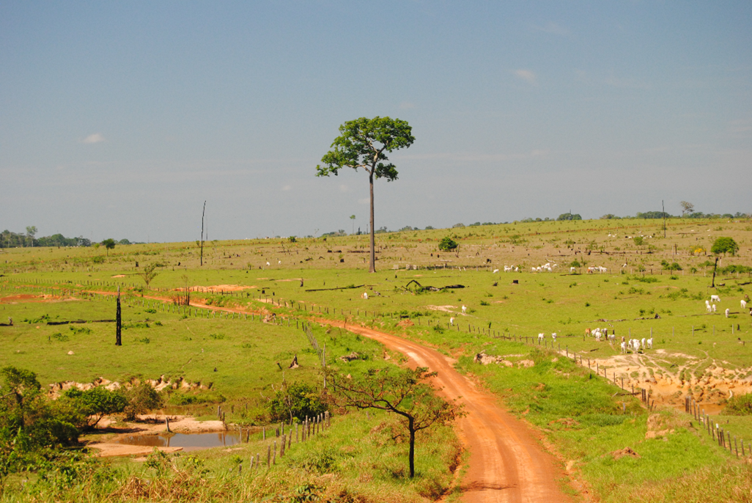
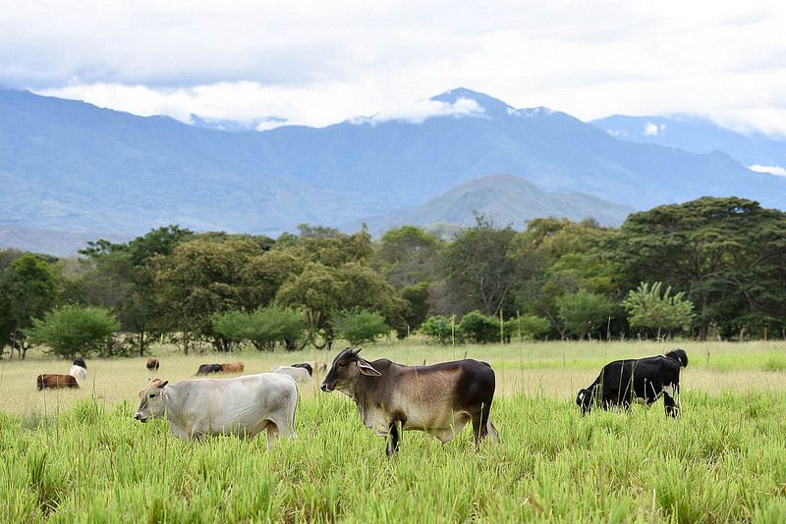



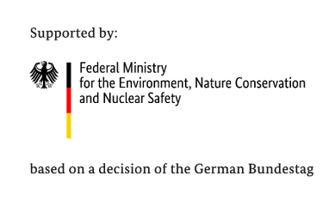
€
Upscaling FLR and involvement of private sector investments, banks and financial intermediaries in meeting NDC goals
IKI Brown Bag Lunch
Till Pistorius and Johannes Mössinger
22.04.2021

Slide 2
Agenda
1 Forest Landscape Investments in Latin America
2 Project Work Streams and Implementing Partners
3 Facilitating FLR Impact Measurement at FI level
4 FLR Impact Frameworks Focus on Four Broad Impact Areas
5 FLR Impact Engine Tool

Slide 3
Forest Landscape Investments in Latin America (FLILA)
project lifetime: 2019 – 2024
implementing partners
main objective: facilitating and upscaling private Forest Landscape Restoration (FLR) investments
key barriers:
Lack of knowledge about FLR investments and their positive impacts (monitoring on Financial Institution level)
Initial investment costs for many FLR land use types are high and payback periods tend to be long
land suitable for FLR is often privately owned and there is lack of knowledge among landowners on FLR practices & benefits
geographical focus:
El Salvador
Peru
Paraguay

Slide 4
Project Work Streams and Implementing Partners
Four work streams to overcome barriers of FLR Investments
1
2
Development of IT-based Impact Monitoring Tool for Financial Institutions
Deal origination support (create a pipeline of bankable FLR projects)
3
4
Technical Assistance for loan/investment beneficiaries
Capacity Building for Green Recovery: Rural Competence Centre for Employment

Slide 5
Facilitating FLR Impact Measurement at FI level
Complexity and novelty of different FLR impact monitoring systems hinder private FLR investments and calls for simplification
How to measure impact of FLR investments?
  Problem: FLR impact monitoring is a relatively new area of research and there is no common impact framework available yet
    Current reality: Too many possible indicators, many of which are highly specific and not SMART for the envisaged purpose
    → Too complex for local financial institutions!
    Actual needs: An open and common FLR Impact Monitoring System with a set of indicators that are:
    SMART (Specific, Measurable, Achievable, Relevant, Time-bound),
    cost-effective and
    contribute to demonstrate financial, environmental and social benefits
Schematic selection process for a single indicator
Restoration target: Restore biodiversity & eco-system services
FLR activities/investments 1
FLR activities/investments 2
e.g. introduction of
agroforestry system
Too complex
Potential effect on
Dimension
Ecological
Economic
Social
Political
Impact Category
Soil
Water
Biodiversity
Climate
Sub-category
Stability
Quality
Management
Sub-sub-category
Physical
Chemical
Biological
Final Indicator
Earthworms
Soil Enzymes
Total organic Carbon
Many more….

Slide 6
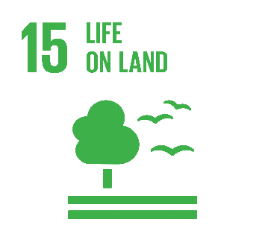















FLR Impact Frameworks Focus on Four Broad Impact Areas
Select restoration goals
Select impact/restoration frameworks analyzed
15.1: conservation, restoration and sustainable use of terrestrial and inland freshwater ecosystems and their services […]
15.2: sustainable management of all types of forests, halt deforestation, restore degraded forests
15.3: […] strive to achieve a land degradation-neutral world
1. Stop forest loss […]
4. Support alternatives for basic needs […]
4 common FLR target/impact areas*
Conservation/Restoration
Production/Economic
Livelihoods/Well-being
Governance
Conserve, maintain or restore biodiversity and eco-system services with focus on forests
Sustainable, productive and ecological agriculture
Sustain or improve livelihoods or local communities
Establish or improve enabling institutions and increase stakeholder engagement

Slide 7






FLR Impact Engine Tool
FLR Impact Engine automates FLR impact estimation process
FLR IMPACT ENGINE
Data at Bank level
Additional data
Automatically accesses existing FI data
Automatically retrieves necessary third party data
Impact Estimation
Automatically generates impact estimates
FLR Impact Report
Conservation/restoration
Production/economic
Livelihoods/well-being

Slide 8
THANK YOU FOR YOUR ATTENTION !
Your FLILA-Team
https://www.flila.org/

